Slide 1
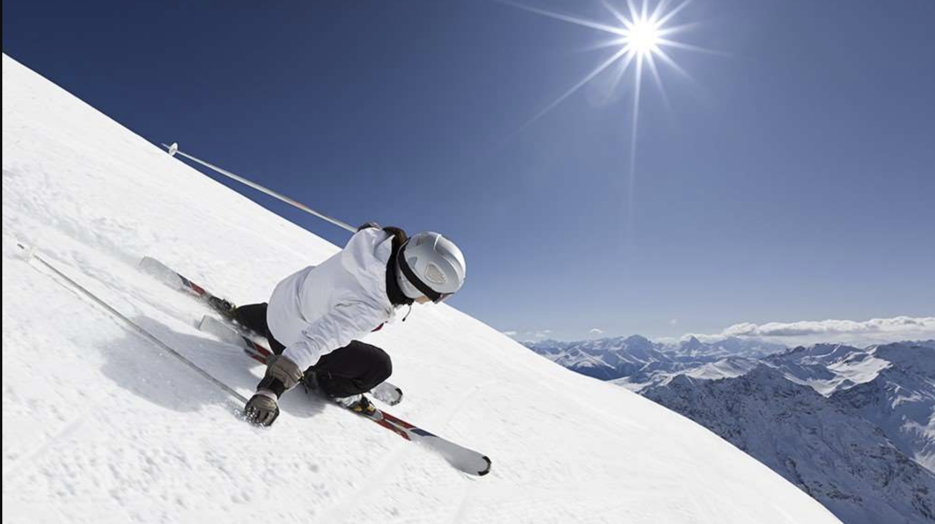
Capitalizing on facilities to predict ideal ticket prices at BIG MOUNTAIN RESORT using machine learning models.

Slide 2
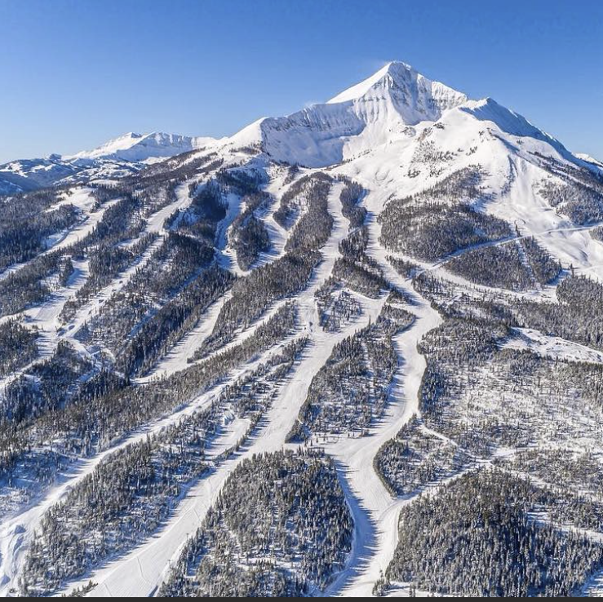
Big Mountain Resort located in Montana offers spectacular views of Glacier National Park and Flathead National Forest with access to 105 trails.
Every year about 350,000 people ski or snowboard at Big Mountain. It can accommodate skiers and riders of all levels and abilities.

Slide 3
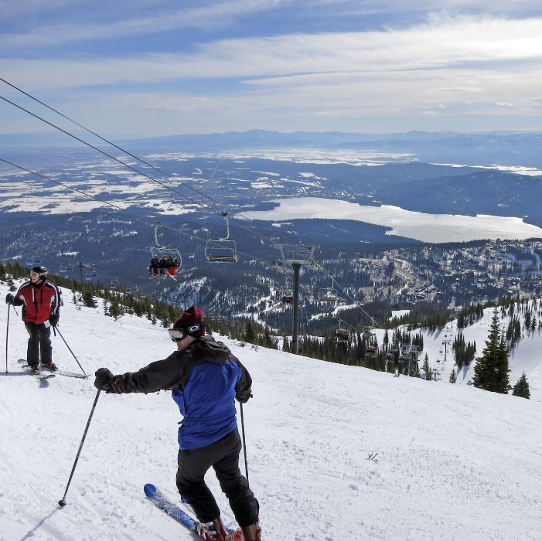

Mountain Resort has recently installed an additional chair lift to help increase the distribution of visitors across the mountain. This additional chair increases their operating costs by $1,540,000 this season. The resort's pricing strategy has been to charge a premium above the average price of resorts in its market segment.
THE PROBLEM
How should Big Mountain Resort maximize capitalization on their facilities by increasing ticket prices above average market prices and cutting operational cost by at least 20% before the end of the year?
KEY DATA SOURCE: Single CSV File

Slide 4

Key finding Increasing the vertical drop by about 150 feet in addition to the new chair lift will increase ticket price Recommendations 1. Ticket price adjustment: Ticket increase by $13 2.Additional facilities: Increasing the vertical drop by about 150 feet in addition to the new chair lift will increase ticket price 3.Closing facilities: Closing 1-2 runs will not significantly impact ticket prices 4.Marketing: New and expanded facilities should be well advertised

Slide 5
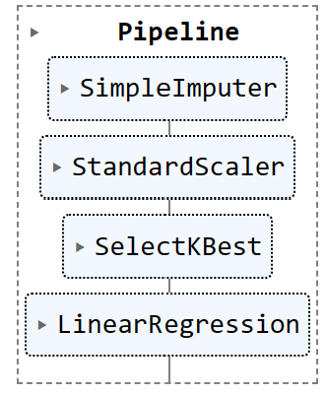
MODEL CREATION
After extracting Big Mountains data and partitioning it into 70/30 train and test splits
Model selection was initiated by building baseline comparator with sklearns DummyRegressor algorithm to test the average ticket price as good mean to predict future ticket prices.
This baseline comparator predicted the future ticket price to be around $19 after assessment
Other models were built with sklearns pipeline and RandomforestRegressor algorithms and results were compared to the baseline

Slide 6

MODEL ASSESSMENT
Results from baseline and other built models were tested with three metrics:
The coefficient of determination,R^2-
The measure of the proportion of variance that is predicted by the model
The Mean Absolute Error(MAE)
The average of all absolute errors(The most intuitive of all three metrics)
The Mean Squared Error(MSE)
The average of the square of errors

Slide 7
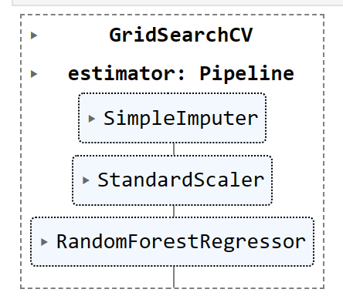
MODEL SELECTION
Missing values were replaced with the median
Models were built with the assumption that all other resorts were largely setting prices based on how much people value certain facilities.
Model was assessed and compared to baseline
Random Forest Model predicted a low MAE result ($1) indicating less errors and variability than pipeline
This model result was the most reliable.
It was also very efficient in selecting the best way to handle missing values.

Slide 8
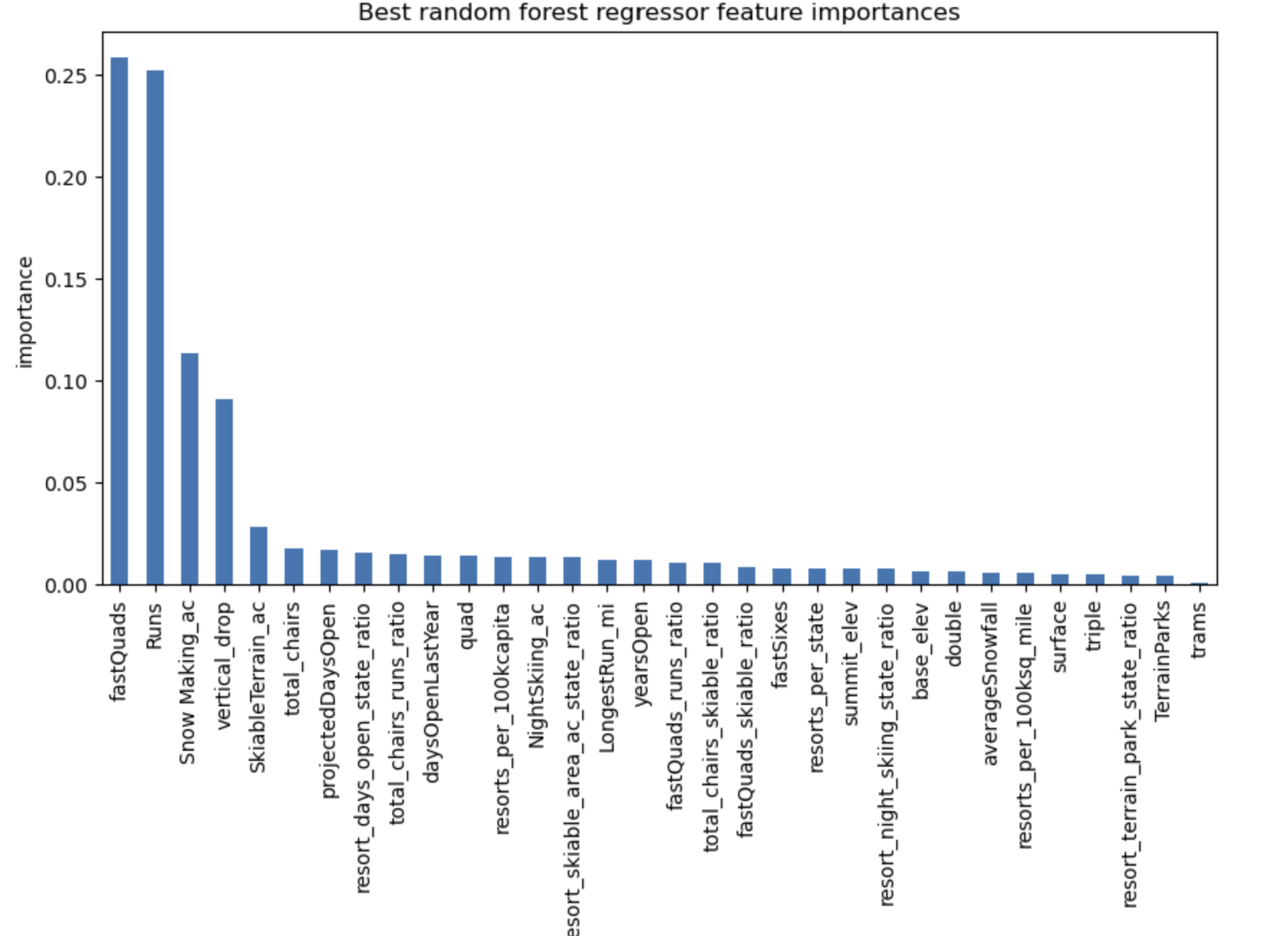
MODEL PREDICTIONS
The model predicted;
The four most important features as fastquads, Runs, Snow making area and vertical drop
The actual price of Big Mountain tickets as $81 and expected price as $95.89
An MAE of $10.39, indicating more room for further ticket price increase
Scenario modelling indicated;
Generation of more than $3M per season(assuming each visitor on average buys 5 day tickets) when vertical drop is increased by 150 feet and coupled with the new chair lift
The closing of 1-2 Runs will not cause any significant effect to ticket price

Slide 9

CONCLUSION
Additional data on operational costs of other important facilities like fastquads and skiable terrain may be useful in the future
Model can be retrained and more scenarios can be modelled and assessed for relevance for price increments.
The RF models predictions and scenario modelling recommendations per the data available could help cut down operational cost by at least 20% while maximizing capital from other expanded and new facilities at Big Mountain Resort before the end of the year.

